Slide 1
FINAL PROJECT PRESENTATION
Buying World Cup Wins and Historical Determinism
Predicting FIFA World Cup Group-Stage Advancement
Jeremy Shiu & Rachel Nguyen
STAT 418 · Tools in Data Science · UCLA Summer 2026 · July 2026

Slide 2
EXECUTIVE SUMMARY
Three pre-tournament factors reliably predict who escapes the World Cup group stage
A logistic model on 366 men’s World Cup team-campaigns (1970–2022) isolates what separates teams that advance — experience, host status, and regional strength — and it holds up out of sample and on the completed 2026 field.
Hosting — largest effect
Experience compounds
Regional strength persists
Host nations advance at roughly eight times the odds of a comparable non-host (p ≈ .002).
Each prior World Cup appearance raises a team’s odds of advancing by about 22% (p < .001).
UEFA and CONMEBOL lead; AFC, CAF, and CONCACAF trail even after controlling for other factors.
366
65% · 0.69
0.757
team-campaigns
accuracy · AUC (out-of-sample)
forward-test AUC
men’s World Cups, 1970–2022
trained 1970–2006, tested 2010–2022
applied to the completed 2026 field
What doesn’t move the needle: squad age, the forward/defender mix, and coach nationality show no detectable effect once experience, host status, and region are accounted for.
Shiu & Nguyen | STAT 418, Tools in Data Science | UCLA Summer 2026
2

Slide 3
High financial and viewership stakes make outcome forecasting a high-value analytical problem
$7.6B
6.6M
5B
Revenue Generated
Fans in Attendance
Total Viewers
During the '22 World Cup
Across 102 games
Engaged across TV & digital
$
Shiu & Nguyen | STAT 418, Tools in Data Science | UCLA Summer 2026
4

Slide 4
EXECUTIVE SUMMARY
Three pre-tournament factors reliably predict who escapes the World Cup group stage
A logistic model on 366 men’s World Cup team-campaigns (1970–2022) isolates what separates teams that advance — experience, host status, and regional strength — and it holds up out of sample and on the completed 2026 field.
Hosting — largest effect
Experience compounds
Regional strength persists
Host nations advance at roughly eight times the odds of a comparable non-host (p ≈ .002).
Each prior World Cup appearance raises a team’s odds of advancing by about 22% (p < .001).
UEFA and CONMEBOL lead; AFC, CAF, and CONCACAF trail even after controlling for other factors.
$7.6B
6.6M
5B
Revenue Generated
Fans in Attendance
Total Viewers
During the ’22 World Cup
Across 102 games
Engaged across TV & digital
What doesn’t move the needle: squad age, the forward/defender mix, and coach nationality show no detectable effect once experience, host status, and region are accounted for.
Shiu & Nguyen | STAT 418, Tools in Data Science | UCLA Summer 2026
3

Slide 5
Project Roadmap
1
Context
4
Modeling
Why group-stage advancement is hard to forecast, and who has a stake in getting it right.
Why logistic regression, and how two model specifications check each other.
2
Data
5
Results
One World Cup dataset from 8 tables joined using SQL.
The three factors that move the needle — and the ones that don’t.
3
EDA
6
Business Implications
What the outcome and early predictor patterns look like before any model is fit.
What federations, analysts, and broadcasters should take from this.
Shiu & Nguyen | STAT 418, Tools in Data Science | UCLA Summer 2026
2

Slide 6
01
1
SECTION 1 OF 6 · CONTEXT
Group-stage advancement is the World Cup's first major competitive milestone.
Shiu & Nguyen | STAT 418, Tools in Data Science | UCLA Summer 2026
3

Slide 7
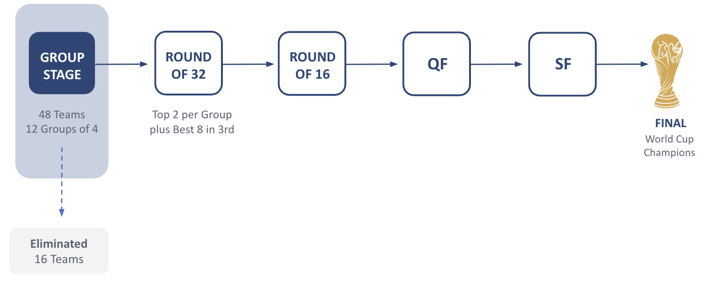
CONTEXT
Group-stage advancement determines a team's tournament trajectory
WHY IT’S HARD TO FORECAST
Tournament occurs every four years
Only three group matches
Small samples amplify randomness
OUR PREDICTION TARGET IS TO ELIMINATE ONE-THIRD OF TEAMS :
48 Teams
32 Advance
16 Eliminated
Shiu & Nguyen | STAT 418, Tools in Data Science | UCLA Summer 2026
4

Slide 8
CONTEXT
Our predicted variable is binary: Does a team Advance or Not Advance?
This study identifies the pre-tournament team characteristics most strongly associated with advancing beyond the FIFA World Cup group stage.
1
2
3
Not a black box
Pre-tournament only
Decision-relevant
Every predictor is knowable before the first match: experience, host status, squad makeup, region.
Federations, sponsors, and analysts plan around advancement, not final point totals.
The goal is an interpretable model that quantifies which characteristics matter — not just a prediction engine.
Shiu & Nguyen | STAT 418, Tools in Data Science | UCLA Summer 2026
5

Slide 9
02
2
SECTION 2 OF 6 · DATA
Data & Methodology
Predictors were built in SQL from raw tournament, squad, and player records — with careful handling of missing data, leakage, and scope.
Shiu & Nguyen | STAT 418, Tools in Data Science | UCLA Summer 2026
6

Slide 10
DATA · SOURCE
Open Source World Cup history
Dataset | Coverage | Role in this study
FIFA World Cup relational database (datahub.io) | 38 linked CSV tables — tournaments, teams, squads, players, matches, bookings, hosts, managers — back to 1930 | Joined via SQL (sqldf in R) into one main data frame for analysis
SCOPE OF THE PRIMARY MODEL
The unit of analysis is a single team's group-stage campaign in a single men's FIFA World Cup. After restricting to men's tournaments from 1970 onward (see next slide), the modeling table contains 366 team-campaigns.
Formula: advanced = prior_tournaments + is_host + conf + other covariates
Shiu & Nguyen | STAT 418, Tools in Data Science | UCLA Summer 2026
7

Slide 11
DATA · FEATURE ENGINEERING
Five predictor blocks translate raw tables into modeling-ready features
Variable | Description | Type
Prior Tournaments | Cumulative World Cup appearances for a nation | Numeric
Squad Composition | Average squad age, squad size, forward/defender share | Numeric
Squad WC Experience | Mean prior World Cup appearances per player (avg_prior_wc) | Numeric
Team Experience | Prior FIFA World Cup appearances for the team | Numeric
Host Nation | 1 if the team is playing in its home country | Binary
Foreign Manager | 1 if the head coach's nationality differs from the team's | Binary
Shiu & Nguyen | STAT 418, Tools in Data Science | UCLA Summer 2026
8

Slide 12
DATA · CLEANING & SCOPE
Five scope decisions keep the comparison fair and the estimates stable
1
2
3
1970 onward
Men's tournaments only
Zeros where zero is correct
The format and qualification rules for the World Cup have changed over time; 1970 and onward provides a more stable baseline
Men's and women's World Cups are separate competitions with different histories and formats; mixing them would break comparability.
Missing card, host, or manager values are coalesced to 0 only where a legitimate zero is the right reading.
4
5
Outcome leakage removed
Collinear predictors dropped
Wins, draws, losses, goals, goal difference, and points are excluded — each directly encodes the outcome being predicted.
Redundant measures are removed to keep coefficients stable and interpretable.
Shiu & Nguyen | STAT 418, Tools in Data Science | UCLA Summer 2026
9

Slide 13
03
3
SECTION 3 OF 6 · EDA
Exploratory analysis reveals consistent patterns before formal modeling
Regional affiliation, tournament experience, and host status each exhibit distinct relationships with group-stage advancement before formal modeling.
Shiu & Nguyen | STAT 418, Tools in Data Science | UCLA Summer 2026
10

Slide 14
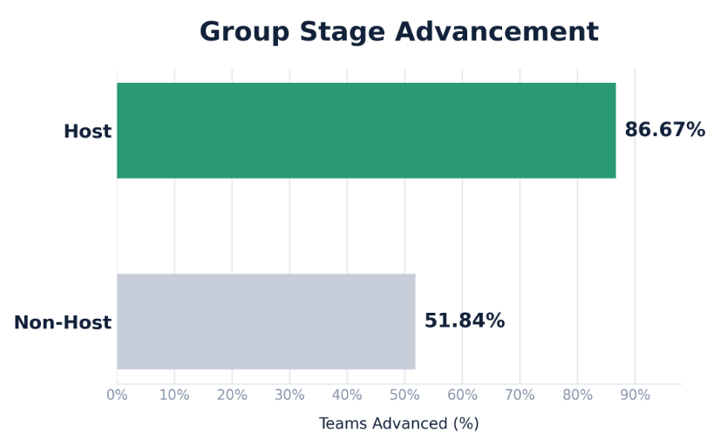
EDA
Host nations exhibit substantially higher advancement rates
WHAT THE DATA SHOWS
87% of host nations advance, compared with 52% of non-hosts.
The difference suggests a meaningful home-field advantage.
These differences are descriptive; Logistic regression tests whether they persist after accounting for experience, host status, and other team characteristics.
Shiu & Nguyen | STAT 418, Tools in Data Science | UCLA Summer 2026

Slide 15
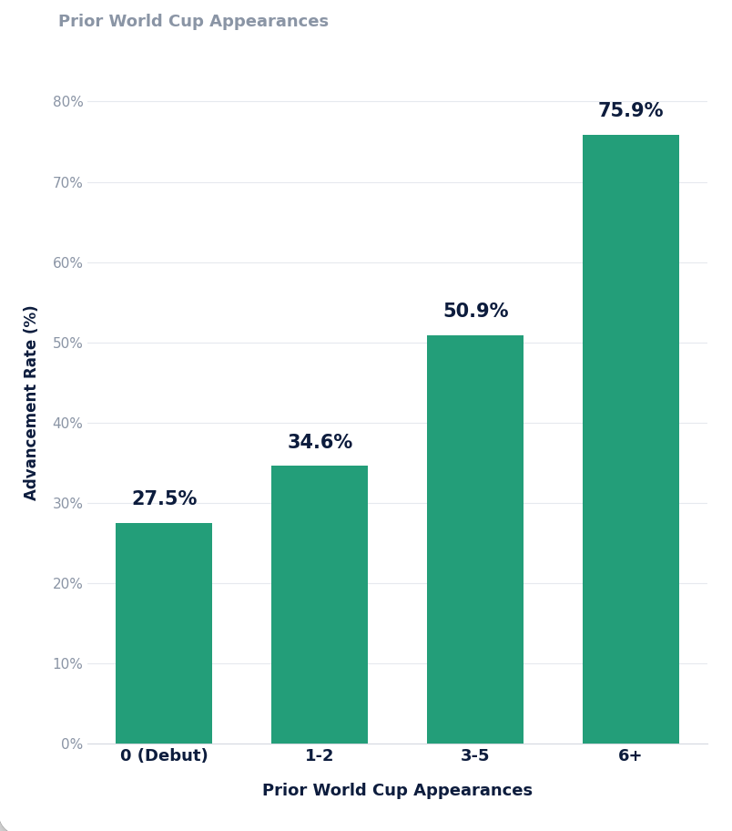
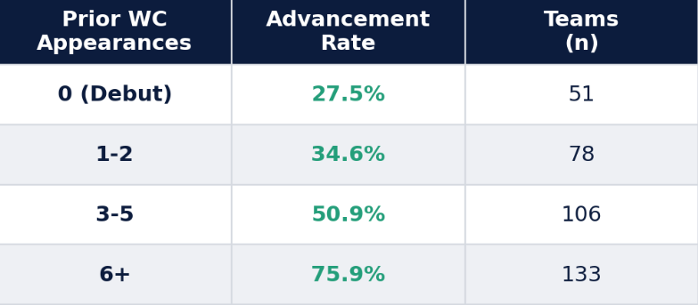
EDA
Experienced teams advance 3x more than new teams
WHAT THE DATA SHOWS
Experienced teams tend to advance more often than first-time participants.
Advancement rates rise from 28% (debut teams) to 76% (6+ appearances).
6+ appearances hints that experience may partly reflect team quality.
Shiu & Nguyen | STAT 418, Tools in Data Science | UCLA Summer 2026

Slide 16
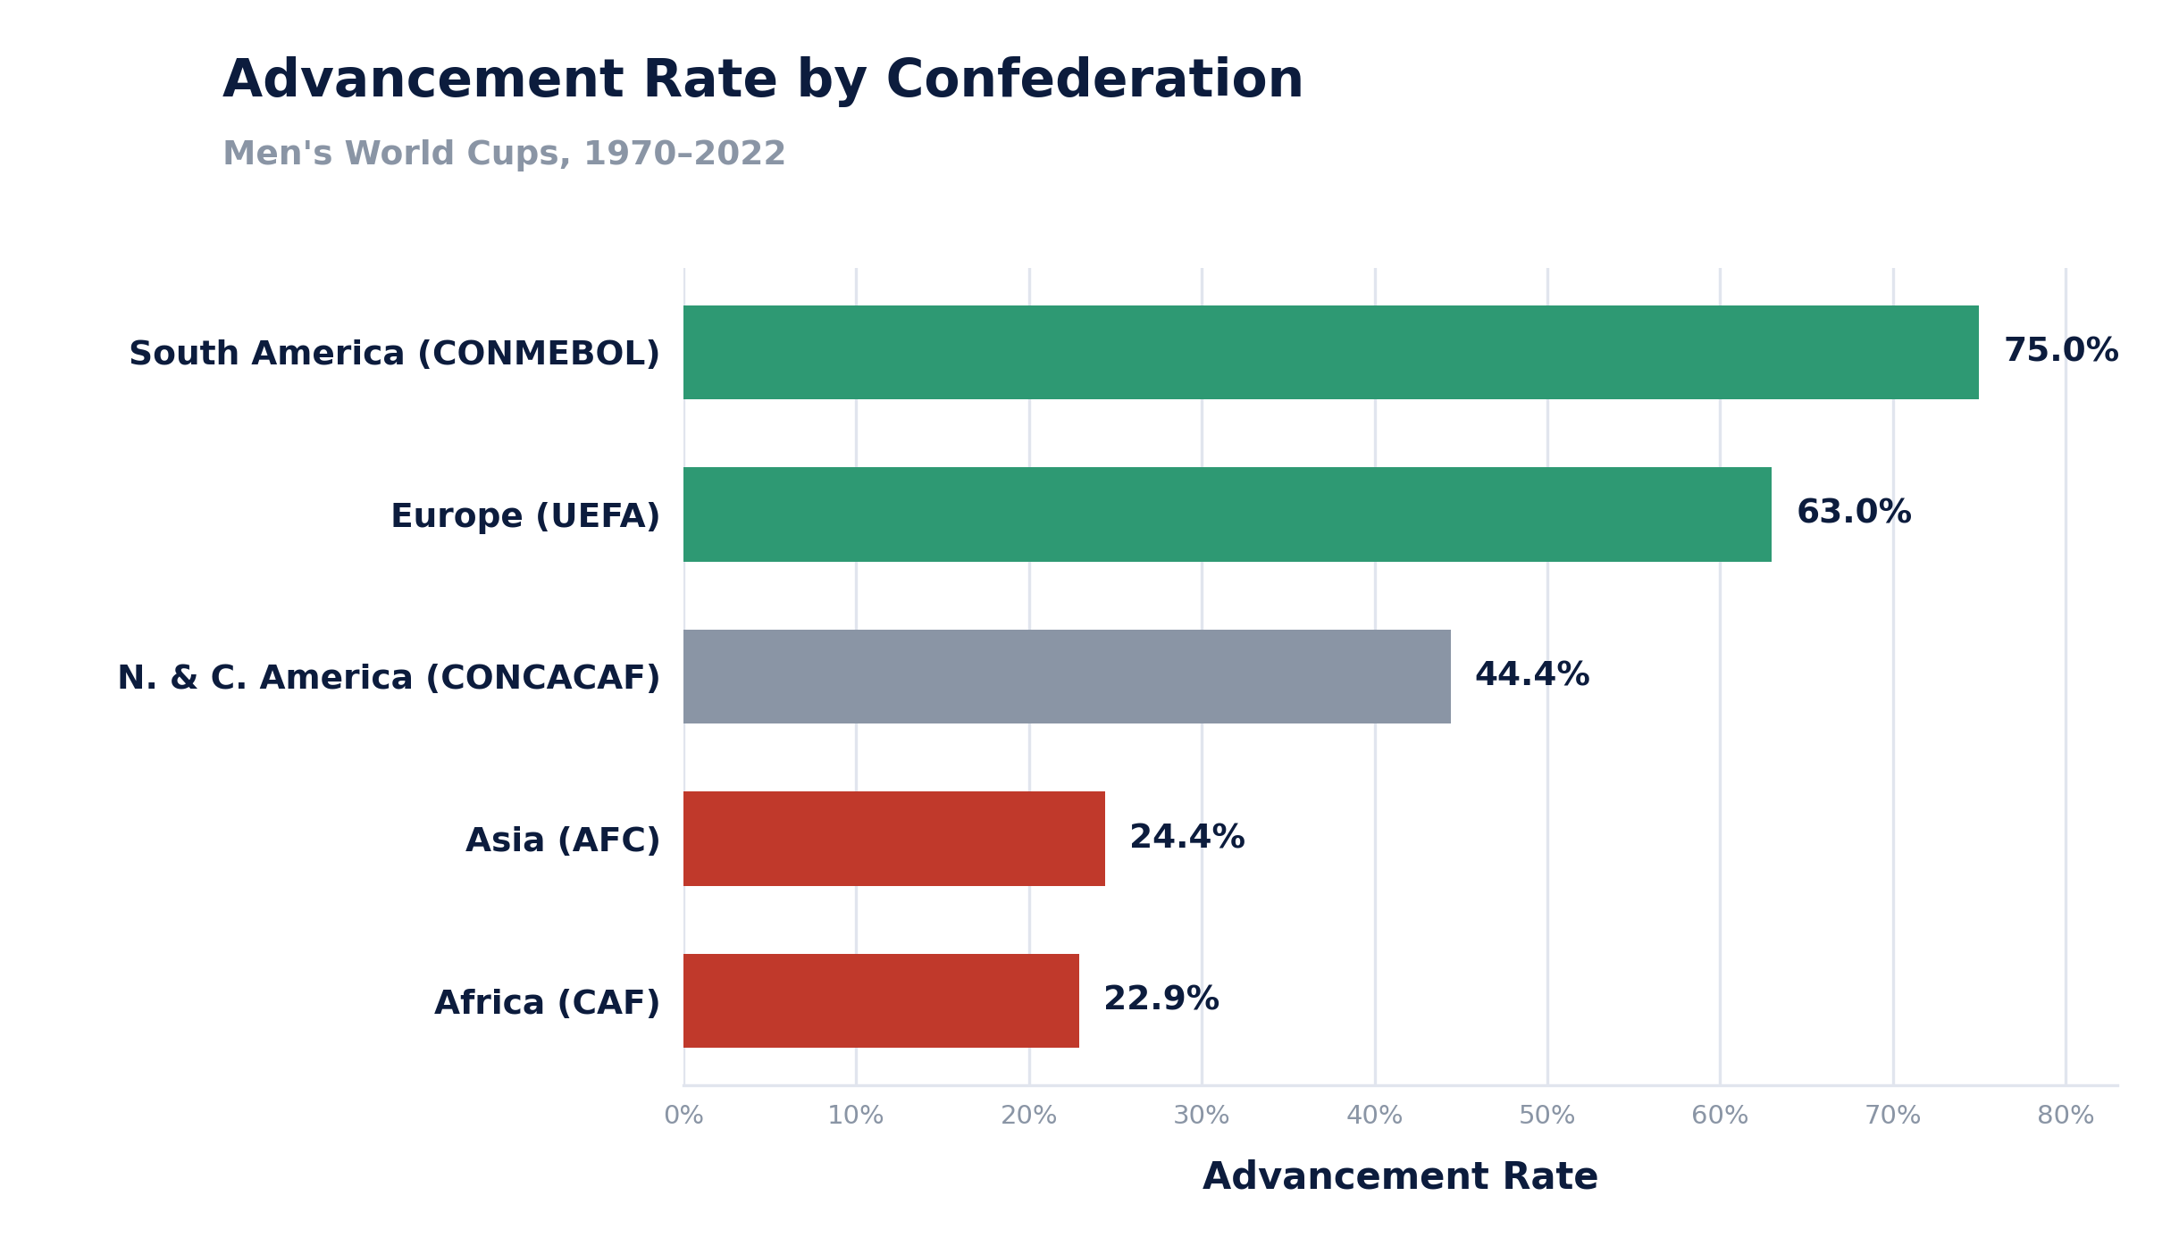
EDA
Regional differences in advancement are evident before modeling
WHAT THE DATA SHOWS
S. American (CONMEBOL) & European (UEFA) teams advance substantially more often than other confederations.
Asian and African teams consistently struggle to qualify.
Shiu & Nguyen | STAT 418, Tools in Data Science | UCLA Summer 2026
12

Slide 17
04
4
SECTION 4 OF 6 · MODELING
The objective is a forecast: predict who advances using only what is known before kickoff
A locked-in, pre-tournament model does the forecasting; an independent variable search confirms it leans on the same drivers — and it is validated on unseen tournaments.
Shiu & Nguyen | STAT 418, Tools in Data Science | UCLA Summer 2026
14

Slide 18
MODELING · APPROACH
Logistic regression was chosen for interpretability over Poisson and ordinal alternatives
Poisson regression
Group-stage points aren't evenly spaced (8 points is impossible) and don't extend to infinity — a poor fit for a bounded, irregular outcome.
REJECTED
Ordinal regression
Preserves an ordered notion of “degree” of success without assuming numeric distance, but is harder to interpret and communicate.
CONSIDERED
Logistic regression
The outcome was simplified to a binary advanced / not-advanced flag — easier to interpret, and it matches how viewers actually think about results.
SELECTED
Trade-off accepted: a binary outcome can't distinguish a dominant group-stage run from a narrow squeak-through — but people ultimately care whether a team advances, not by how much.
Shiu & Nguyen | STAT 418, Tools in Data Science | UCLA Summer 2026
14

Slide 19
MODELING · SPECIFICATION
Model 1 forecasts results; Model 2 stress-tests it separately
 | Model 1 — Forecasting spec | Model 2 — Robustness check
Specification | Fixed in advance and knowable before kickoff: experience, squad composition, host status, foreign manager, confederation | Stepwise AIC search over a wider candidate pool, including squad size and total cards
Purpose | Forecasting — scores a team before a ball is played; also yields valid significance claims | Predictive / sanity check — an independent read on which factors matter
Potential Issues | Nations recur across tournaments, may be issues with independence of observations | P-values run optimistic (searching many combinations flatters the best one) — not cited for significance claims
Result | Experience, hosting, and region are statistically reliable predictors | Independently selects the same three headline drivers
Both were also validated out-of-sample: fit on tournaments before 2010, scored against 2010–2022 and the completed 2026 field
Shiu & Nguyen | STAT 418, Tools in Data Science | UCLA Summer 2026
15

Slide 20
05
5
SECTION 5 OF 6 · RESULTS
Three factors reliably predict group-stage advancement — hosting matters most
Tournament experience, host status, and regional strength move the needle. Squad age, position mix, and coach nationality do not.
Shiu & Nguyen | STAT 418, Tools in Data Science | UCLA Summer 2026
16

Slide 21
KEY TAKEAWAYS
Three factors drive group-stage advancement
Tournament experience compounds
Each additional prior World Cup appearance raises a team's odds of advancing by roughly 22% (p < .001)
Hosting is the single largest effect
Host nations advance at roughly eight times the odds of a comparable non-host (p ≈ .002)
Regional gaps persist after controlling for quality
AFC, CAF, and CONCACAF teams advance at roughly one-fifth to one-third the odds of UEFA teams (each p < .03). CONMEBOL performs on par with UEFA.
Shiu & Nguyen | STAT 418, Tools in Data Science | UCLA Summer 2026
17

Slide 22
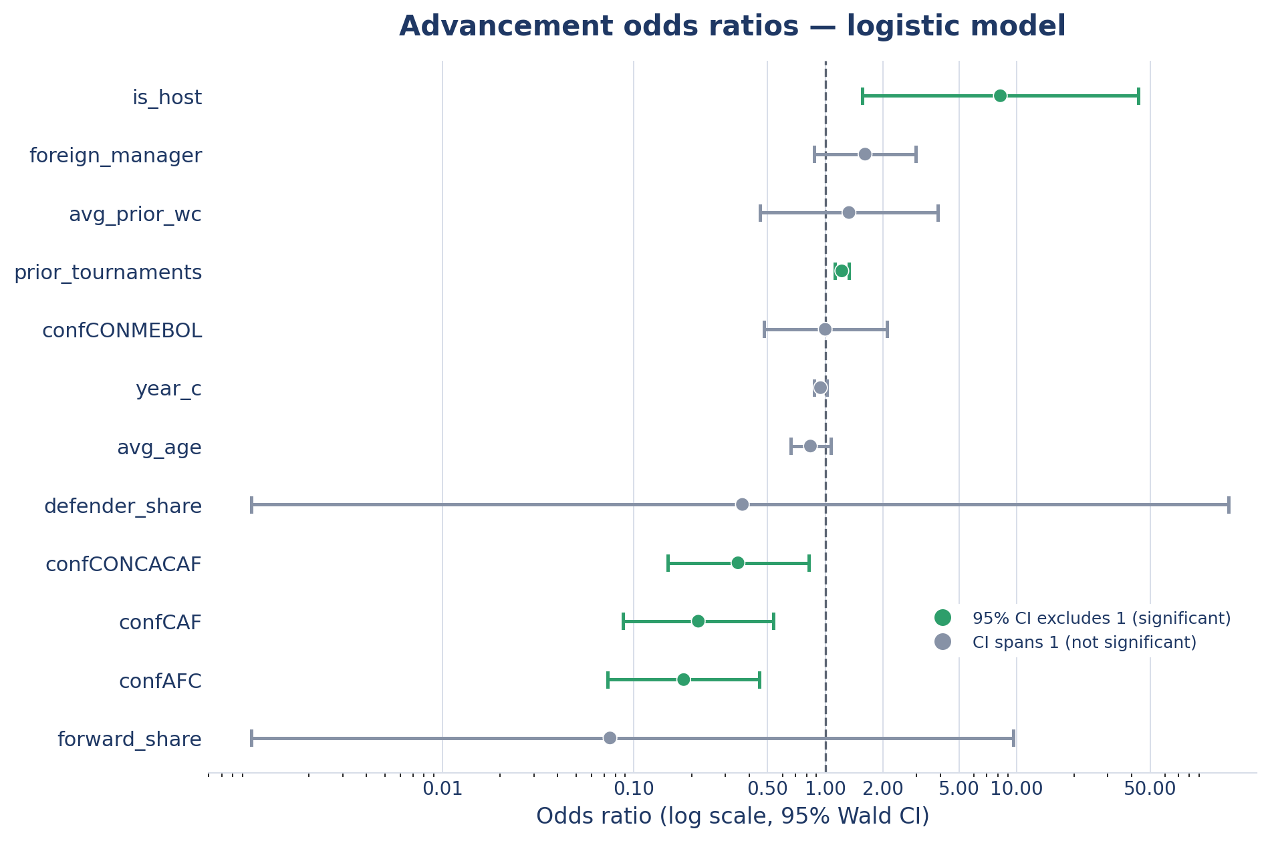
RESULTS
Experience, hosting, and region emerge as the strongest independent predictors
WHAT THE MODEL SHOWS
Host nations have the largest competitive advantage, with substantially higher odds of advancing than non-hosts.
Prior World Cup experience increases the likelihood of advancement, even after accounting for region and squad characteristics.
Teams from AFC, CAF, and CONCACAF have significantly lower odds of advancement than UEFA teams, while South America (CONMEBOL) is statistically comparable to UEFA after adjustment.
Shiu & Nguyen | STAT 418, Tools in Data Science | UCLA Summer 2026
18

Slide 23
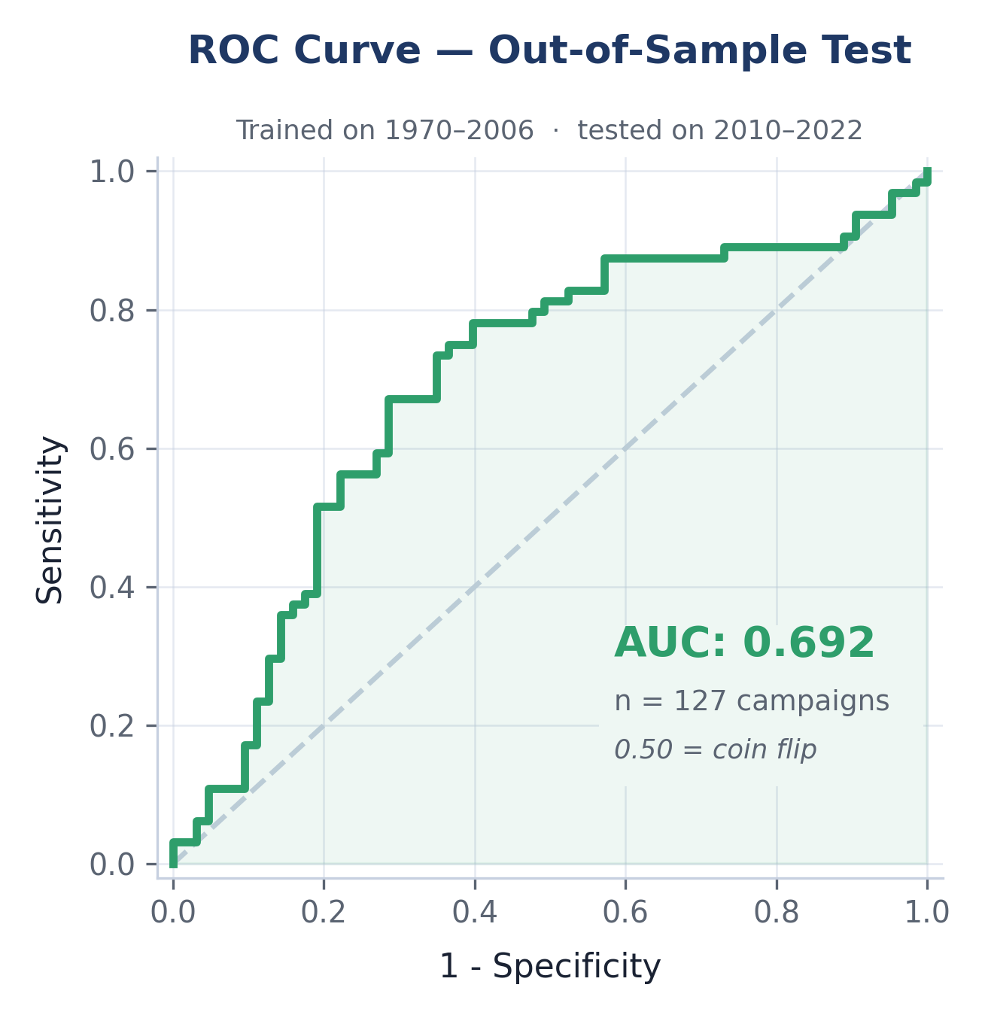
RESULTS · MODEL PERFORMANCE
Trained on 1970–2006, the model holds a 15-point edge on tournaments it never saw
50%
65%
Naive baseline
Out-of-sample accuracy
always guess “advances”
2010–2022, held out
0.69
239 / 127
Out-of-sample AUC
Train / test campaigns
0.50 = coin flip, 1.00 = perfect
1970–2006 vs 2010–2022
Fit on the ten tournaments through 2006 and scored on the four most recent, the model calls 65% of campaigns correctly against a 50% naive baseline — evidence of a real, generalizable signal rather than a fit to historical noise.
Shiu & Nguyen | STAT 418, Tools in Data Science | UCLA Summer 2026
19

Slide 24
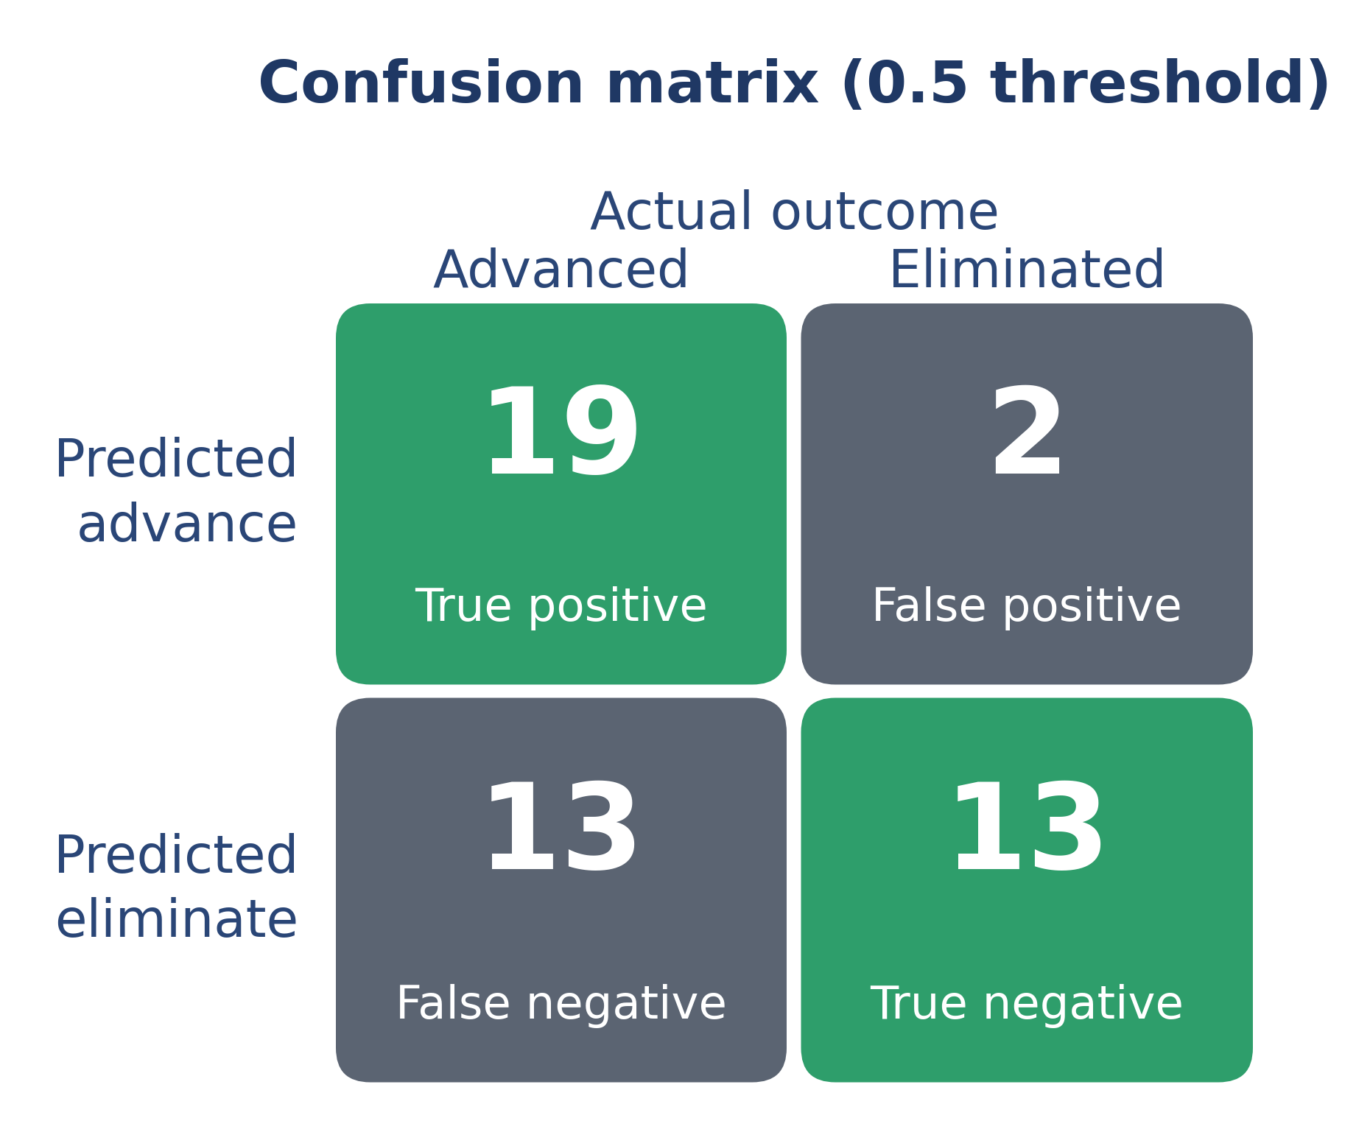
RESULTS · 2026 FORWARD TEST
The model encounters some issues when predicting 2026 result
0.757
0.681
Forward-test AUC
Forward accuracy
2026 field, out-of-sample
equals the base rate — no lift
47
19 / 13
Teams scored
Correct calls (TP / TN)
48-team field, NZ (OFC) dropped
vs. 2 false positives, 13 missed
AUC (0.757) is the honest read: the model orders the field well — hosts and veterans on top — but the expanded 48-team format advances two-thirds of teams, so headline accuracy adds no lift over the base rate.
Shiu & Nguyen | STAT 418, Tools in Data Science | UCLA Summer 2026
20

Slide 25
06
6
SECTION 6 OF 6 · BUSINESS IMPLICATIONS
Organizations should prioritize long-term competitive development over short-term roster adjustments when evaluating World Cup readiness.
Experience, hosting, and regional strength are the strongest drivers of advancement
Shiu & Nguyen | STAT 418, Tools in Data Science | UCLA Summer 2026
21

Slide 26
BUSINESS IMPLICATIONS
Long-term experience and structural advantages matter more than short-term roster decisions
1
2
3
National Federations
Analysts & Broadcasters
Forecasting & Betting
Tournament experience, host status, and confederation provide a more evidence-based foundation for pre-tournament forecasts than narrative-driven predictions.
Experience, host status, and confederation strength provide a quantified, defensible baseline for pricing advancement probability ahead of a tournament.
Sustained World Cup participation and player development are associated with higher advancement rates.
Short-term changes, such as squad age or manager nationality, showed little measurable impact.
CAVEAT FOR 2026
The expanded 48-team format changes advancement dynamics. While the model maintained reasonable discrimination (AUC ≈ 0.76), future tournaments should be evaluated as additional data become available.
Shiu & Nguyen | STAT 418, Tools in Data Science | UCLA Summer 2026
22

Slide 27
Appendix
Schauberger, G., & Groll, A. (2018). Predicting matches in international football tournaments with random forests. Statistical Modeling. https://doi.org/10.1177/1471082X18799934
Szczecinski, L., & Roatis, I. I. (2022). FIFA ranking: Evaluation and path forward. Journal of Sports Analytics. https://doi.org/10.3233_JSA-200619
Fjelstul, J. C. (2023). The Fjelstul World Cup Database (Version 1.2.0) [Data set]. GitHub. https://github.com/jfjelstul/worldcup
The Global Statistics. (2026, July 20). FIFA World Cup 2026 revenue statistics | Key facts. https://www.theglobalstatistics.com/fifa-world-cup-revenue-statistics/
Full SQL construction query, stepwise model-selection output, and reproducible R code are available in the project repository and full report appendix.
Shiu & Nguyen | STAT 418, Tools in Data Science | UCLA Summer 2026
24

